Slide 1
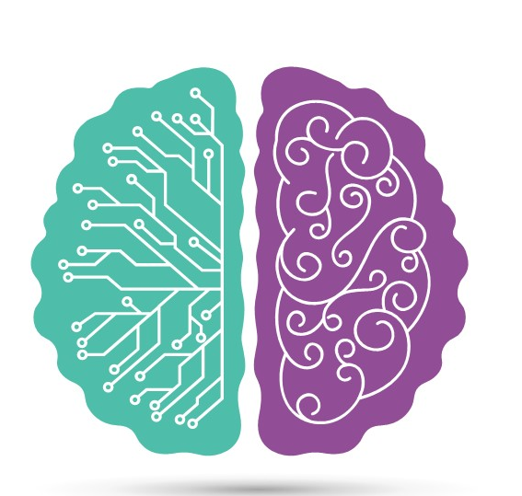
Federated Learning
Revolutionizing Collaborative
Machine Learning

Slide 2

OVERVIEW
Definition of federated learning
Federated Learning is a machine learning approach that enables the training of models across decentralized devices or servers while keeping the data localized and private.
Importance in the field of machine learning
Federated learning has emerged as an important concept in the field of machine learning due to several key reasons:
Privacy and Data Security
Data Accessibility and Diversity
Scalability and Efficiency
Edge Computing and IoT Applications

Slide 3
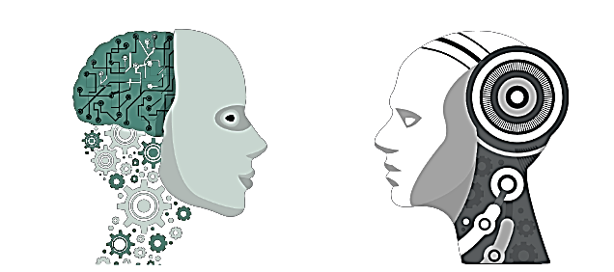
Federated Learning V/S Machine Learning
Federated Learning:
Decentralized data
Model training on multiple devices or server
Heterogeneous data distribution
Communication efficiency
Traditional Machine Learning:
Centralized data
Model training on a single server
Homogeneous data distribution
Predominantly batch learning

Slide 4
How Federated Learning Works
Federated learning is a decentralized approach to machine learning where the training of models is performed locally on distributed devices.
It allows multiple entitiesto collaboratively train a shared machine learning model while keeping the data local and private.
Steps involved in the process:
1) Initialization 2) Local Model Training 3) Model Updates
4) Aggregation 5) Iterations 6) Privacy and Security
7) Model Deployment

Slide 5
Roles of Procedure
Initialization :Central server prepares a global mode land distributes it to the participating devices or servers.
Local Model Training: Each participating server independently trains the global model using its local dataset.
Model Updates: After local training instead of sending the raw data to the central server, only the model updates or gradients are sent.
Aggregation: The central server collects the model updates . Then aggregates the updates to create an updated global model.
Iterations: Steps 2-4 are repeated iteratively, allowing the local models to improve over time.
Model Deployment: Once the process is completed the will be deployed word wide.

Slide 6



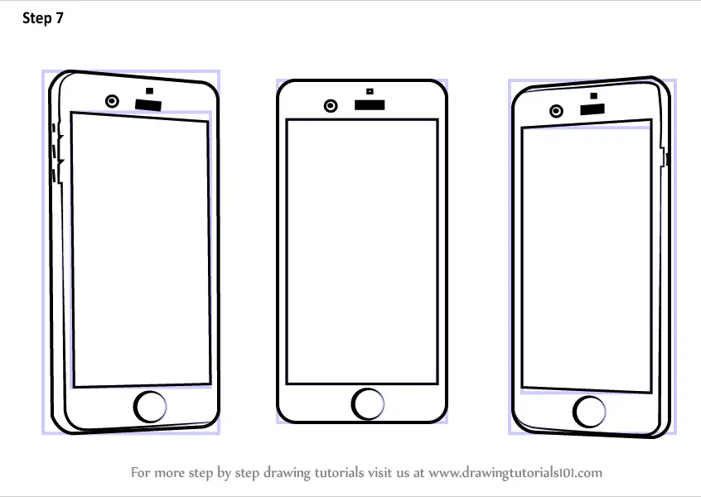
Diagrammatic Representation
Model Deployment
Initialization
Local Model Training
Central server
Iteration
Model Updates
Devices or servers
Aggregation

Slide 7
Applications of Federated Learning
Healthcare:Collaborative analysis of patient data across hospitals to predict disease outcomes.
Finance:Fraud detection without sharing sensitive customer information across banks.
Transportation:Collaborative traffic prediction for efficient routing without revealing individual location data.
And many more.

Slide 8
Benefits of Federated Learning
Privacy preservation:
Data will not be shared with any central servers or to any third parties.
Leverage distributed data:
Access to diverse data sources without centralizing data.
Reduced data transfer:
Only model updates are shared, minimizing bandwidth usage.

Slide 9
Challenges and Limitations
Communication : Coordinating with huge number of devices or servers leads to communication disturbances.
Security risks: Data privacy and preventing cyber attacks on client devices or servers.
Robust algorithms: Handling heterogeneous and noisy data sources for accurate model training.

Slide 10
Existing Federated Learning Frameworks and Tools
TensorFlow Federated: This is is an open-source framework developed by Google that enables federated learning and computation.
This provides programming model and set of tools for implementing federated learning algorithms and running computations on distributed devices.
PySyft: It is an open-source library and framework built on top of PyTorch, a deep learning framework.
It provides tools and functionalities for privacy-preserving, secure, and decentralized machine learning.

Slide 11
IBM Federated Learning: IBM Federated Learning is an implementation of the federated learning approach developed by IBM.
It is a privacy-preserving machine learning framework that allows multiple parties to collaboratively build a shared model without sharing their raw data

Slide 12
Features of Tools and Frameworks
TensorFlow Federated:
Flexible Computation
Federated Aggregation
Custom Federated Algorithms
Simulations and Experiments
Integration with TensorFlow Ecosystem
PySyft:
Privacy-Preserving Techniques
Secure Multi-Party Computation
Homomorphic Encryption
Private Machine Learning Algorithms
Syft Tensor and Remote Executio
Seamless Integration with PyTorch
IBM Federated Learning:
Privacy-Preserving Collaboration
Secure Aggregation
Differential Privacy
Model Governance and Control
Scalability and Performance
Integration with IBM Watson and IBM Cloud
Collaborative AI

Slide 13

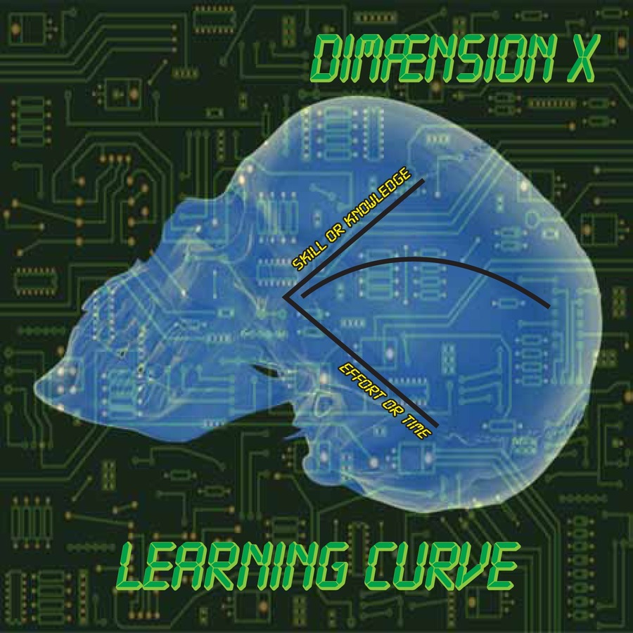
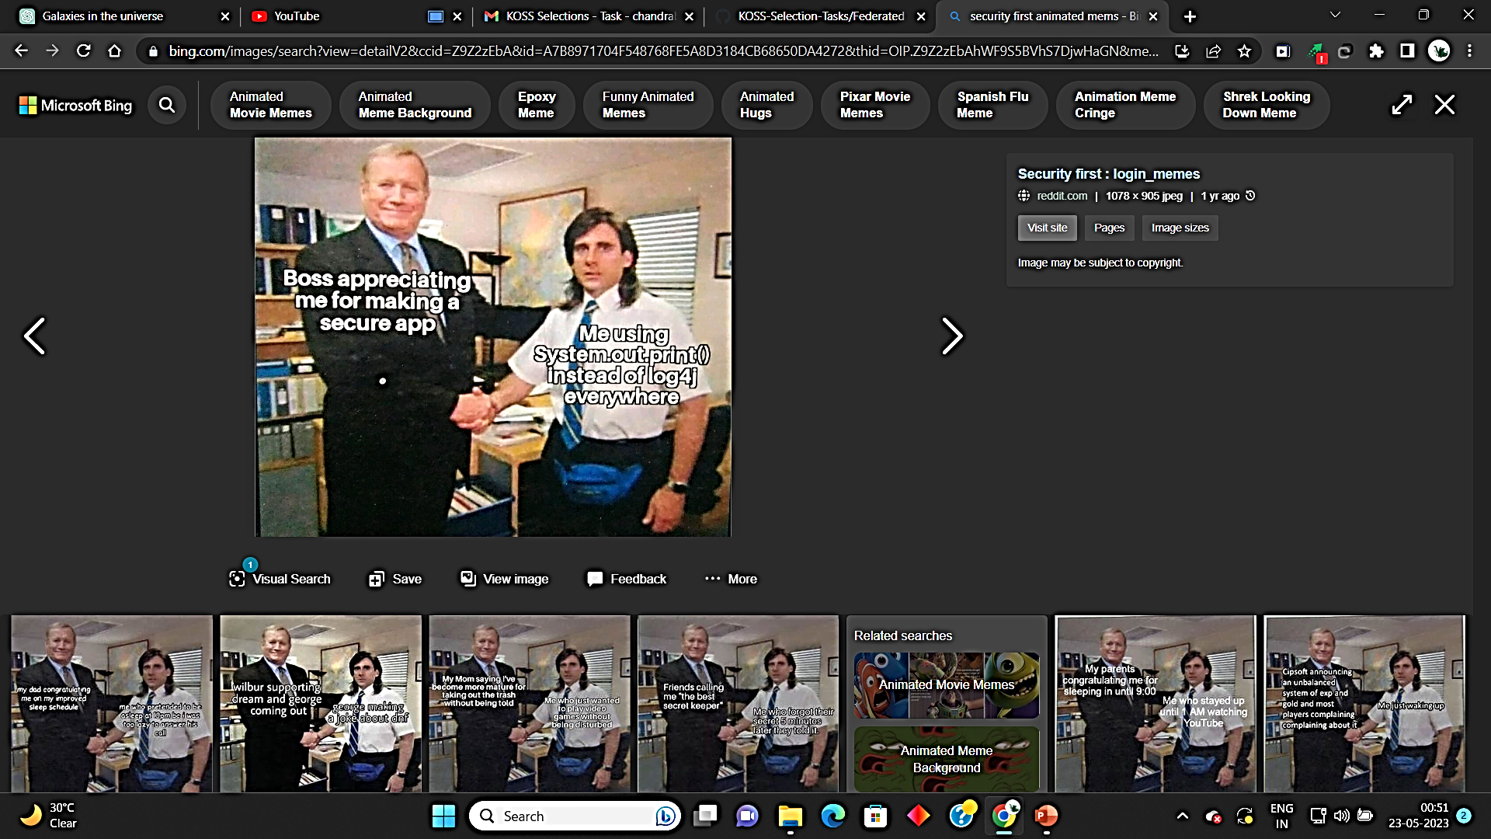
Limitations of Frame works and Tools
Most common problems faces by these tools are:
Learning Curve
Scalability Challenges
Security Assumptions
Limited Tooling and Ecosystem
Performance Overhead
Limited Ecosystem and Community

Slide 14
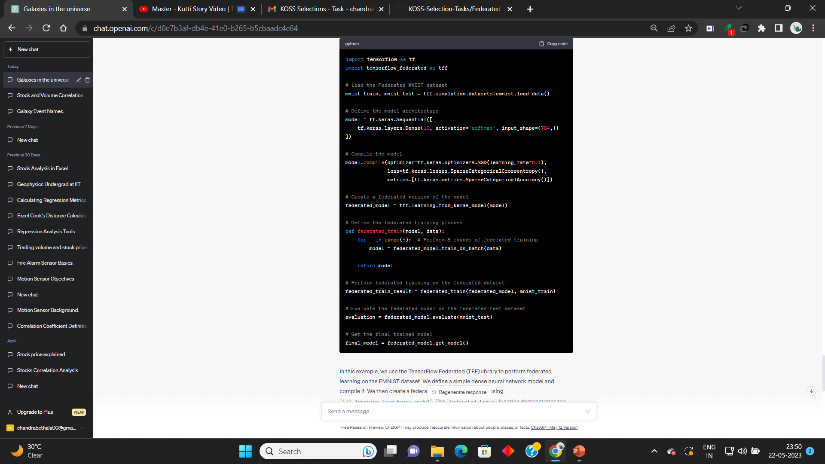
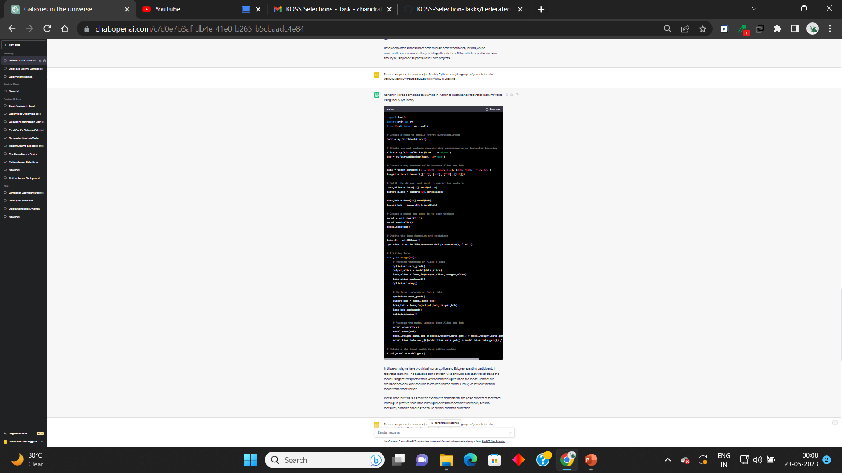








Example code snippet:
Credit goes to ChatGpt
TensorFlow Federated:
PySyft:
IBM Federated learning:
(Not available in ChatGpt)
LINKS for code :https://docs.google.com/document/d/1WBoLkNkI7s11dz_5Fabh42ux-Ddsx7Nyi3C-ZpC0M7g/edit?usp=share_link

Slide 15

Thank You name: B.Chandra Vadhan Raj email:chandrabethala00@gmail.com contact:8653678739

